Slide 1
A Bibliometric Analysis
The Impact of
Artificial Intelligence and Machine Learning
on the Banking Sector
Ravi Kumar Jain
PhD 2023
Roll no. - 07

Slide 2
Introduction
AI/ML is transforming banking by improving efficiency, customer engagement, risk management, and compliance.
The study analyzed 190 academic articles to understand how AI/ML is being used in banking.
Four main areas of AI/ML use were found: managing bank performance, customer relationships (CRM), marketing, and risk.
Specific uses include: finding fraud, credit scoring, predictive analytics, and automating customer service.
New trends are emerging, like using explainable AI (XAI) for clearer decision-making and predictive models to anticipate customer actions and market changes.
The study also found areas where more research is needed, such as ethical AI, real-time systems, and using unsupervised learning in banking.

Slide 3
Research Questions
How have AI/ML been applied in the banking sector to address key challenges?
What are the emerging trends in AI/ML research in banking?
What gaps exist in the current literature on AI/ML applications in banking?
How can bibliometric and thematic analyses contribute to identifying future research directions?

Slide 4
Methodology
S.No. | Step | Description
1 | Database Selection | Scopus was chosen for its wide coverage.
2 | Keyword Search | A comprehensive keyword search was used, including terms like "banking" and "artificial intelligence“ and “Machine Learning”. Logical operators and filters refined the search.
3 | PRISMA Framework | The PRISMA framework guided the study selection process.
4 | Bibliometric Analysis | Biblioshiny and VOSviewer facilitated the bibliometric analysis.
5 | Thematic Analysis | Nvivo enabled thematic analysis.
6 | Data Analysis | Findings were integrated to identify trends and gaps.
7 | Reporting | Results were presented in a structured format.

Slide 5
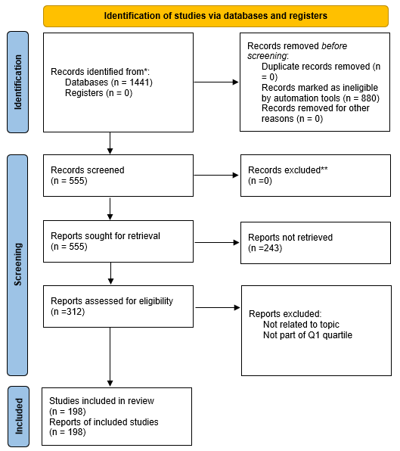
Study Selection Process
(PRISMA Flow Diagram)
Initial pool: 1,441 records identified.
Automated screening removed 880 irrelevant/duplicate entries.
243 records unavailable, leaving 312 reports for eligibility assessment.
Final selection: 198 high-quality studies based on topic relevance and Q1 quartile.

Slide 6
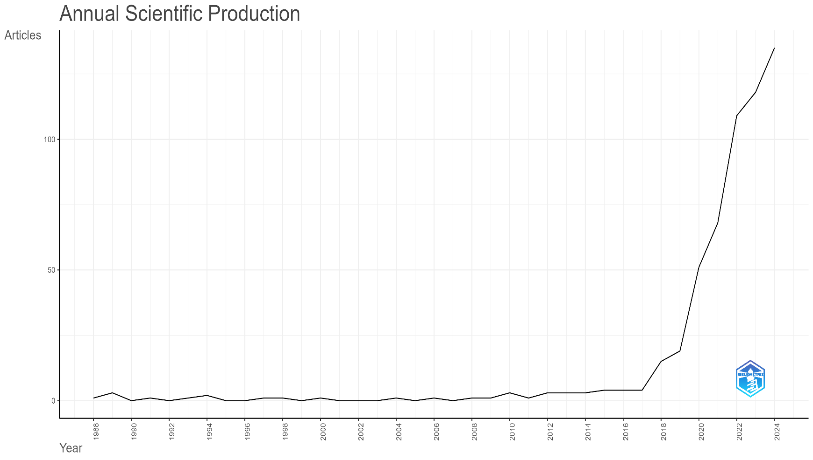
Annual Scientific Production
Research output remained low and stable from 1988 to 2016.
A sharp increase in publications from 2017 onward.
Reflects growing interest and advancements in AI/ML for banking applications.

Slide 7
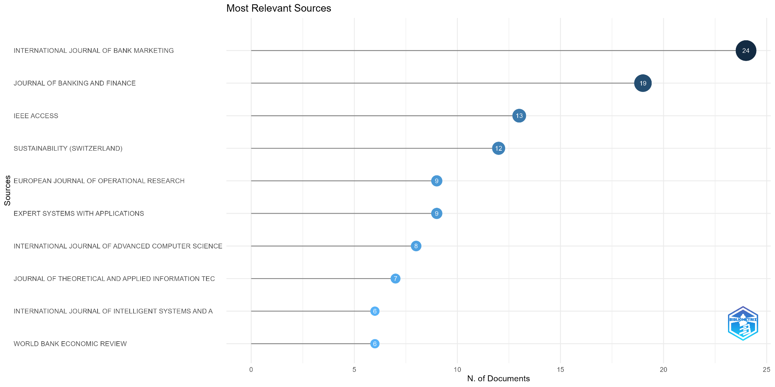
Most Relevant Sources
Top journals publishing AI/ML research in banking:
International Journal of Bank Marketing (24 articles).
Journal of Banking and Finance (19 articles).
IEEE Access (13 articles).

Slide 8
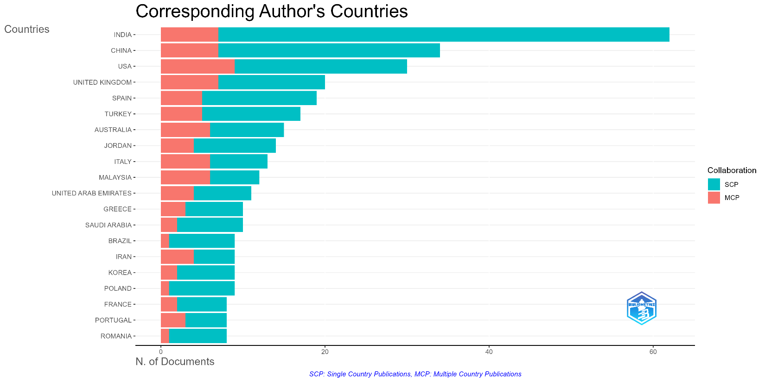
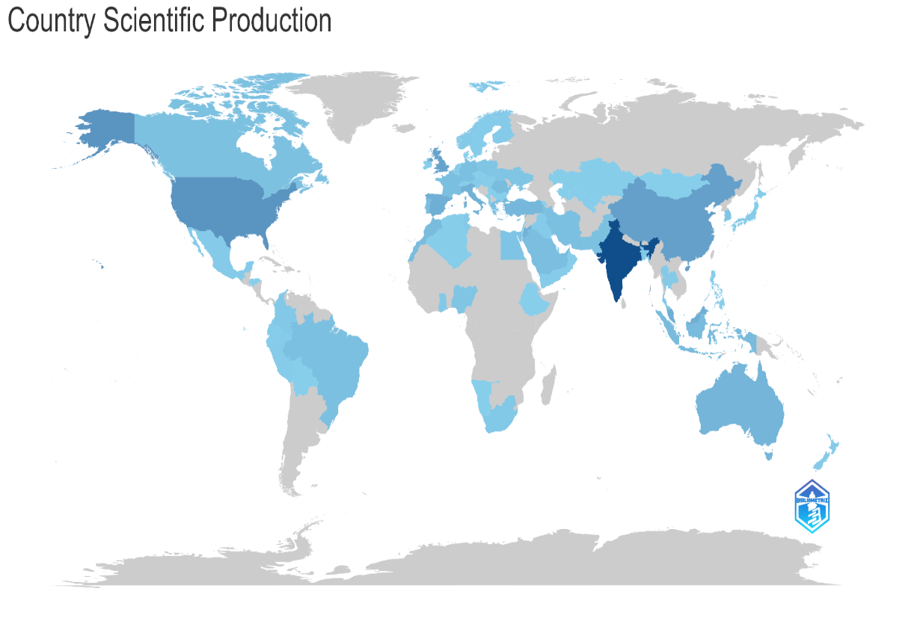
Corresponding Author’s Countries
Top contributing countries:
India, China, USA, and UK dominate AI/ML research in banking.
India and China show strong domestic research efforts.
USA and UK exhibit balanced collaboration with multiple-country publications.
Visual representation of country-wise research output.
Highlights the global interest in AI/ML applications in banking.
Emphasizes contributions from both developed and emerging economies.
SCP: Single Country Publication
MCP: Multiple Country Publication

Slide 9
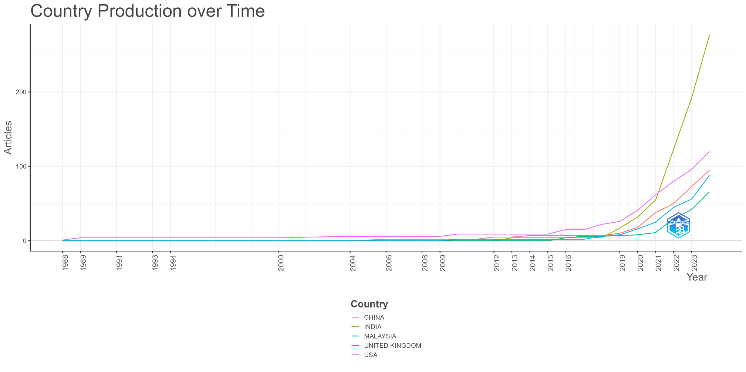
Country Production Over Time
Notable research growth from China, India, Malaysia, UK, and the USA post-2016.
Correlates with the increasing integration of AI/ML in banking operations.
Demonstrates research expansion in response to technological advancements.

Slide 10
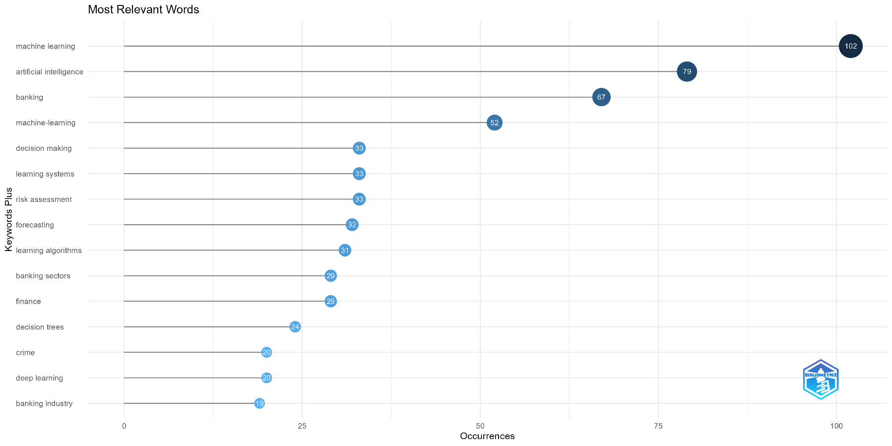
Most Relevant Keywords
Top keywords in AI/ML banking research:
“machine learning” (102 occurrences), “artificial intelligence” (79 occurrences), banking (67 occurrences)

Slide 11
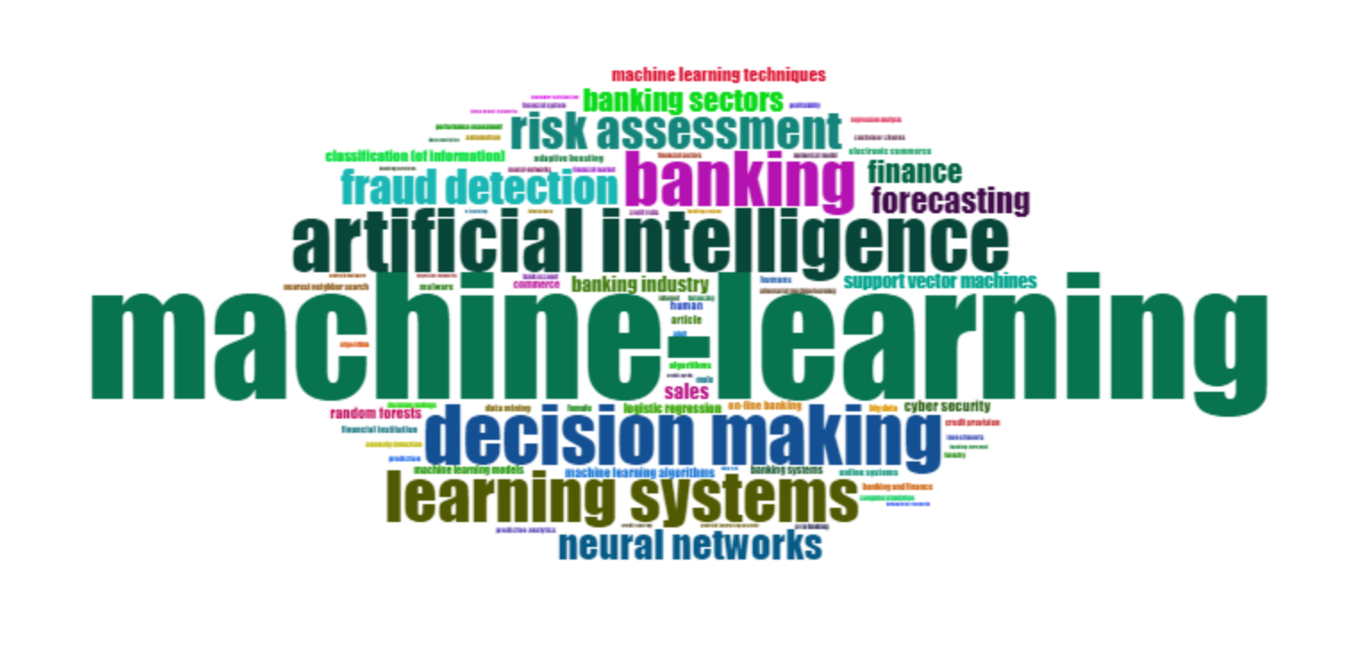
Word Cloud
Visual representation of frequently used research terms.
Larger font sizes represent dominant research topics.
Reinforces the importance of AI/ML in risk management and financial decision-making.

Slide 12
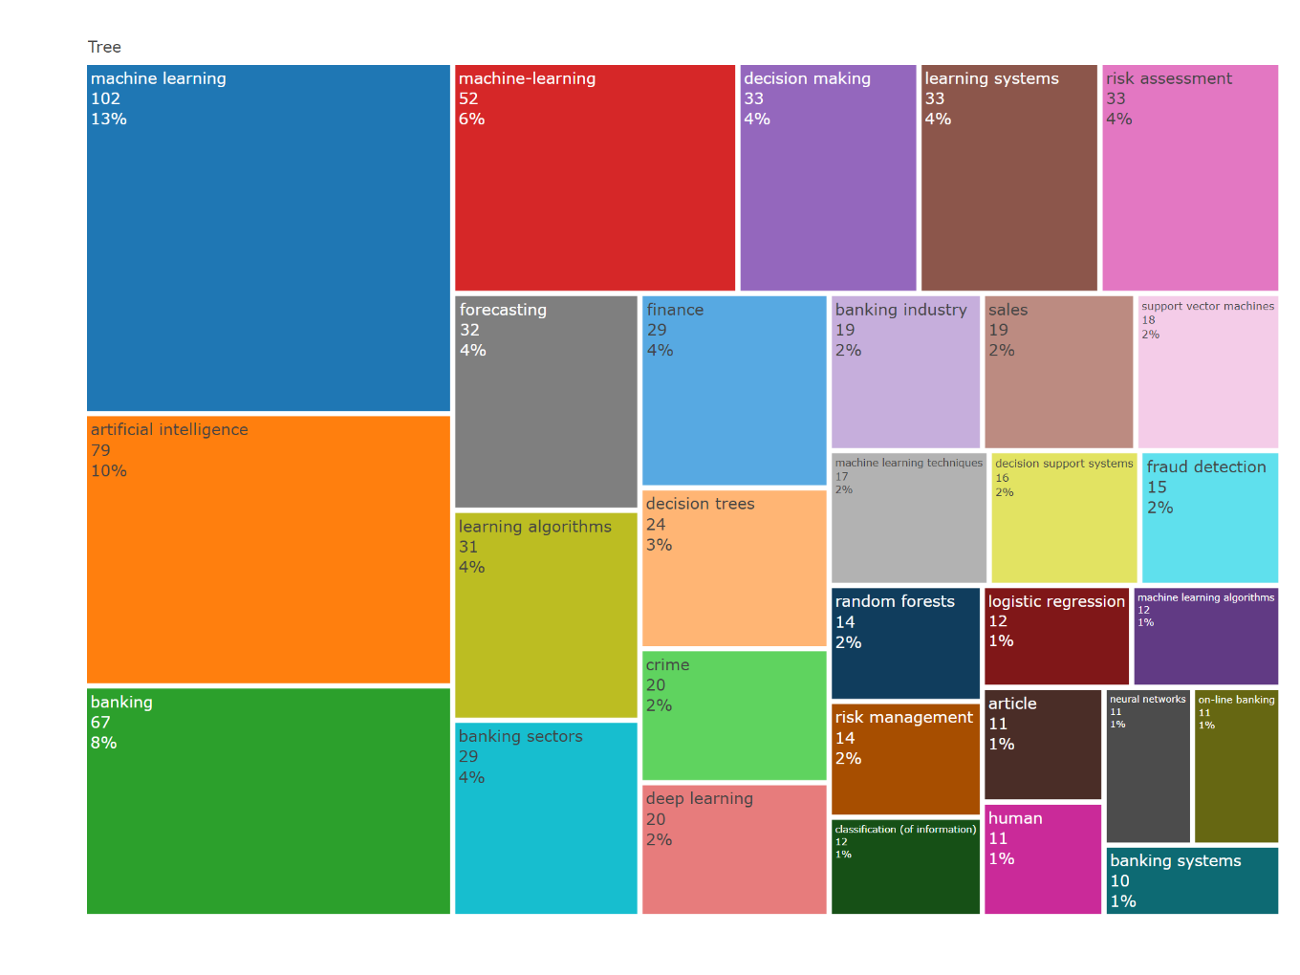
Word Treemap
Comparative visualization of key research themes.
Highlights major topics like fraud detection, machine learning models, and risk assessment.
Identifies secondary research areas such as cybersecurity and support vector machines.

Slide 13
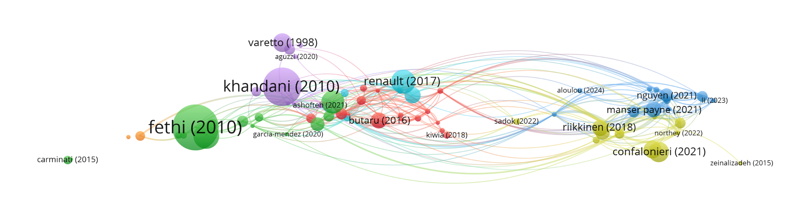
Bibliographic Coupling Analysis
Illustrates connections between highly cited publications.
Foundational works such as Khandani (2010) and Fethi (2010) form key clusters.
Highlights major themes like credit risk modeling and operational efficiency.

Slide 14
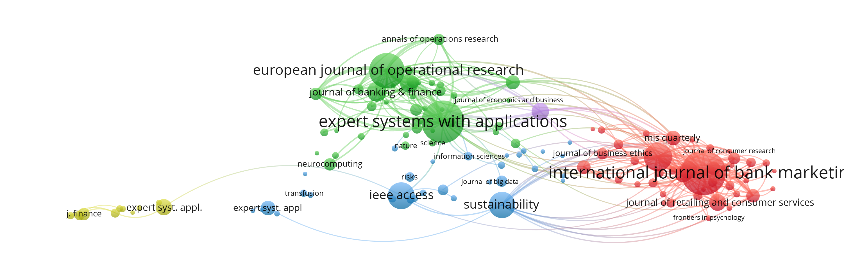
Co-Citation Analysis of Journals
Most influential journals in AI/ML banking research:
International Journal of Bank Marketing, Expert Systems with Applications, European Journal of Operational Research.
Strong connections to IEEE Access indicate growing interest in AI ethics and sustainability.

Slide 15
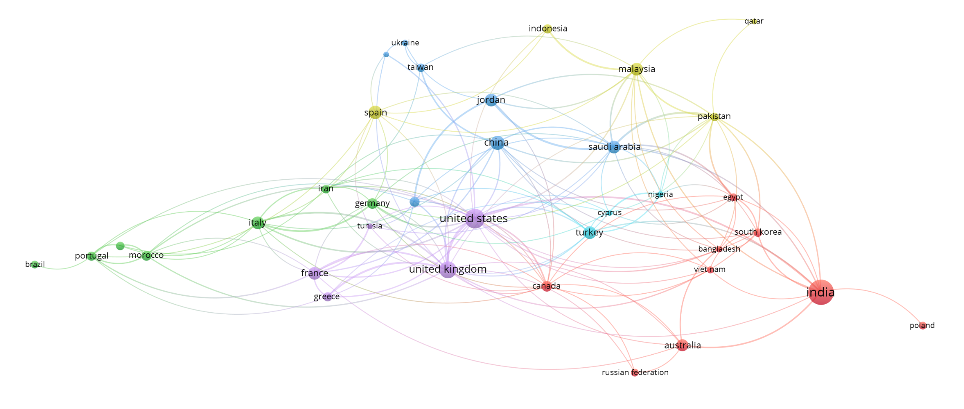
Co-Authorship Network by Country
India, USA, and UK are central hubs in research collaboration.
Thick links indicate strong co-authorship relationships, such as India-USA partnerships.
Reflects the global nature of AI/ML-driven banking research.

Slide 16
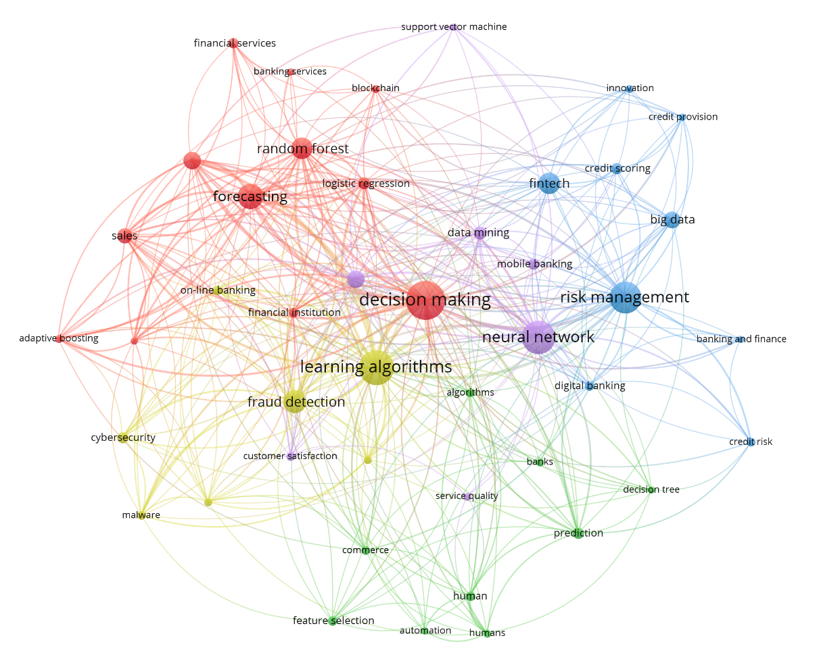
Co-Occurrence Network of Keywords
Shows keyword relationships in AI/ML banking research.
Central themes include "decision-making," "risk management," and "fraud detection."
Emerging topics highlight AI applications in cybersecurity and financial analytics.

Slide 17
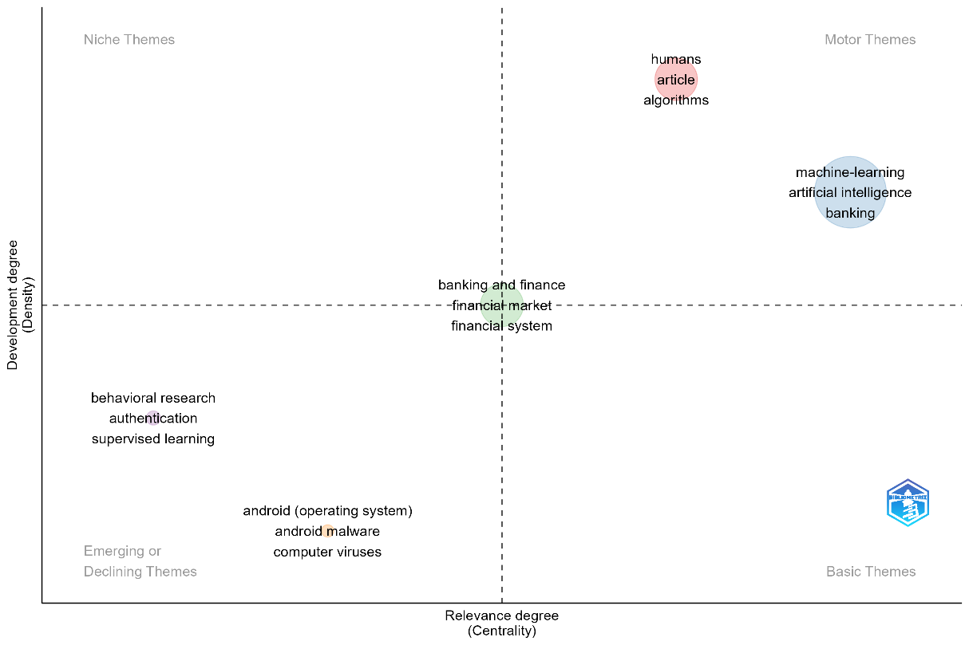
Thematic Map
Categorizes research themes based on centrality and density.
Core themes: Decision-making, learning systems, and risk assessment.

Slide 18
Using Nvivo for Literature Review
Project Setup: Start a new NVivo project.
Import Literature: Bring in your research articles.
Coding: Create a system to label and sort data.
Themes: Find and refine key topics.
Visualize: Make charts and diagrams of your findings.
Integrate: Combine with other tools for a complete picture.

Slide 19
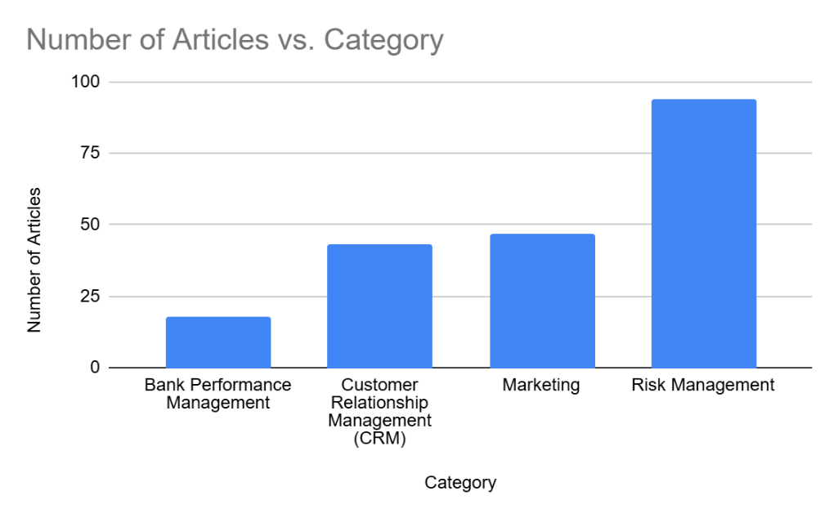
AI / ML in Banking: Categories and Sub-Categories
Category | Sub-Category | Number of Articles
Bank Performance Management | Bank Performance Management | 18
Customer Relationship Management (CRM) | Customer churn prediction and retention, Customer service automation and personalization, Portfolio and wealth management | 43
Marketing | Cross-selling, Customer segmentation, Customer segmentation Technology adoption, Technology critique, Predictive analytics and market forecasting | 47
Risk Management | Credit risk management, Fraud detection and anti-money laundering (AML), Bank failure prediction, Liquidity risk, Operational risk, Systemic risk management, Operational efficiency and process automation, Regulatory compliance and risk management | 94

Slide 20
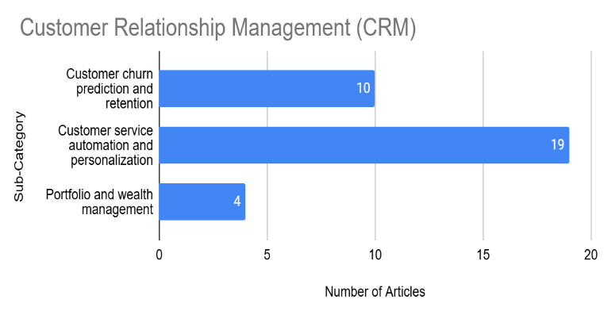
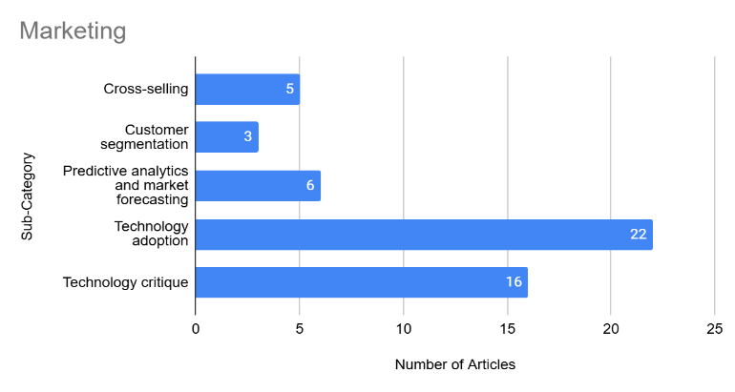
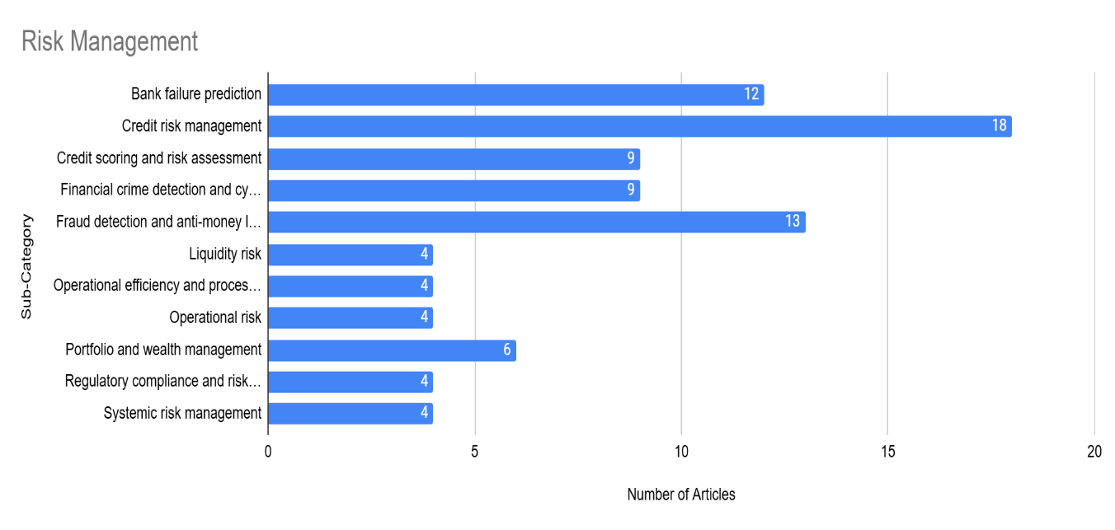
AI / ML in Banking: Categories and Sub-Categories
Category | Sub-Category | Number of Articles
Bank Performance Management | Bank Performance Management | 18
Customer Relationship Management (CRM) | Customer churn prediction and retention | 10
 | Customer service automation and personalization | 19
 | Portfolio and wealth management | 4
Marketing | Cross-selling | 5
 | Customer segmentation | 3
 | Predictive analytics and market forecasting | 6
 | Technology adoption | 22
 | Technology critique | 16
Risk Management | Bank failure prediction | 12
 | Credit risk management | 18
 | Credit scoring and risk assessment | 9
 | Financial crime detection and cybersecurity | 9
 | Fraud detection and anti-money laundering (AML) | 13
 | Liquidity risk | 4
 | Operational efficiency and process automation | 4
 | Operational risk | 4
 | Portfolio and wealth management | 6
 | Regulatory compliance and risk management | 4
 | Systemic risk management | 4

Slide 21
Summary of Trending Topics in AI/ML in Banking
Topic | Methods Used | Objective | Research Gaps
Credit Risk | Support Vector Machines, Neural Networks, Decision Trees, Hybrid models | Credit worthiness, Loan default risk | Data imbalance, Model bias, Explainable AI
Customer Churn | Neural Networks, Statistical models, Rule-based algorithms | Customer churn, Customer retention | Data heterogeneity, Model scalability, Explainable AI
Technology Adoption | Quantitative surveys, Hybrid models, Machine learning | Technology acceptance, User adoption | Generational differences, Societal impacts, Ethical AI
Bank Failure | Statistical models, Machine learning, Early warning systems | Bank failure, Financial distress | Data imbalance, Model accuracy, Real-time prediction
Fraud Detection | Imbalanced classification, Machine learning, Deep learning | Fraud detection, Anti-money laundering | Dynamic fraud patterns, Ethical concerns, Real-time analytics
Customer Service | AI, Case-based reasoning, Machine learning | Customer satisfaction, Service efficiency | Ethical AI, Legacy systems, Human-centric service
Credit Scoring | Machine learning, Explainable AI | Credit score, Default prediction | Dataset imbalance, Model interpretability, Fairness
Cybersecurity | Behavioral analysis, Machine learning | Threat detection, Fraud prevention | Insider threats, Ethical practices, Sustainability
Bank Performance | Data analytics, Machine learning | Bank efficiency, Profitability | Data quality, Analytics talent, Regulatory conditions
Liquidity Risk | ANNs, BNs, Ensemble models | Liquidity risk, Early warning systems | Cultural considerations, Dynamic risk, Model interpretability
Market Forecasting | Hybrid models, Machine learning | Transaction forecasting, Cash demand | Model accuracy, Data heterogeneity, Feature extraction
Operational Risk | AI/ML, Bayesian networks | Operational risk, Risk events | Model validation, Bias in training data, Explainable AI
Systemic Risk | Theoretical frameworks, Machine learning | Systemic risk, Contagion effects | Dynamic and unpredictable events, Procyclicality, ESG integration

Slide 22
Summary of Trending Topics in AI/ML in Banking
Topic | No. of Articles | Keywords
Bank Performance Management | 18 | Bank efficiency, Profitability, Data quality, Analytics talent, Regulatory conditions
Customer Churn Prediction and Retention | 10 | Customer churn, Customer retention, Data heterogeneity, Model scalability, Explainable AI
Customer Service Automation and Personalization | 19 | Customer satisfaction, Service efficiency, Ethical AI, Legacy systems, Human-centric service
Technology Adoption | 22 | Technology acceptance, User adoption, Generational differences, Societal impacts, Ethical AI
Bank Failure Prediction | 12 | Bank failure, Financial distress, Data imbalance, Model accuracy, Real-time prediction
Fraud Detection and Anti-Money Laundering (AML) | 13 | Fraud detection, Anti-money laundering, Dynamic fraud patterns, Ethical concerns, Real-time analytics
Credit Scoring and Risk Assessment | 9 | Credit score, Default prediction, Dataset imbalance, Model interpretability, Fairness
Financial Crime Detection and Cybersecurity | 9 | Threat detection, Fraud prevention, Insider threats, Ethical practices, Sustainability
Portfolio and Wealth Management | 6 | Personalized investment advice, Customer portfolios
Liquidity Risk Management | 4 | Liquidity risk, Early warning systems, Cultural considerations, Dynamic risk, Model interpretability
Predictive Analytics and Market Forecasting | 6 | Transaction forecasting, Cash demand, Model accuracy, Data heterogeneity, Feature extraction
Operational Risk Management | 4 | Operational risk, Risk events, Model validation, Bias in training data, Explainable AI
Systemic Risk Management | 4 | Systemic risk, Contagion effects, Dynamic and unpredictable events, Procyclicality, ESG integration
Operational Efficiency and Process Automation | 4 | Automated tasks, Operational efficiency
Regulatory Compliance and Risk Management | 4 | Regulatory compliance, Risk management, Explainable AI
Cross-selling | 5 | Cross-selling, Customer relationship management (CRM), Marketing
Technology Critique | 16 | Technology adoption, Risk management, Regulatory compliance, Operational efficiency

Slide 23
Conclusion: How have AI/ML been applied in the banking sector to address key challenges?
AI/ML significantly improves fraud detection, credit risk management, and customer service.
Machine learning models such as anomaly detection outperform traditional fraud prevention techniques, enabling real-time fraud prevention.
AI-driven predictive analytics enhance customer churn management by offering retention strategies based on behavior patterns.
Chatbots and virtual assistants improve customer engagement, reducing response time and operational costs.

Slide 24
Conclusion: What are the emerging trends in AI/ML research in banking?
Increasing adoption of cybersecurity-focused AI to protect sensitive financial data.
The rise of explainable AI (XAI) to improve transparency and trust in AI-driven financial decisions.
AI-based regulatory compliance automation helps banks reduce penalties and meet legal requirements efficiently.
Predictive analytics are advancing, allowing financial institutions to anticipate customer behavior and mitigate market risks.

Slide 25
Conclusion: How can bibliometric and thematic analyses contribute to identifying future research directions in AI/ML for banking?
Bibliometric analysis reveals key research trends, influential authors, and collaboration patterns.
Thematic analysis highlights critical research areas such as fraud detection, predictive analytics, and customer relationship management (CRM).
The study identifies gaps in cybersecurity, real-time AI applications, and regulatory compliance, shaping future research priorities.
Tools like Biblioshiny and VOSviewer provide structured insights into AI/ML applications, helping refine research strategies.

Slide 26
Research Gaps in AI/ML for Banking
Unsupervised Learning: More research needed on using unsupervised learning for tasks like anomaly detection and customer segmentation.
Ethical Concerns: AI models must be fair and unbiased, especially in credit scoring and loan approvals.
Real-Time Systems: Current models mostly use historical data. Need to develop systems that adapt to real-time information for better decision-making.
Explainability: Many AI models are complex and hard to understand. More research on explainable AI (XAI) is needed to increase transparency and trust.

Slide 27
References
Doumpos, M., Zopounidis, C., Gounopoulos, D., Platanakis, E., & Zhang, W. (2023). Operational research and artificial intelligence methods in banking. European Journal of Operational Research, 306(1), Article 1. https://doi.org/10.1016/j.ejor.2022.04.027
Kalyani, S., & Gupta, N. (2023). Is artificial intelligence and machine learning changing the ways of banking: A systematic literature review and meta-analysis. Discover Artificial Intelligence, 3(1), Article 1. https://doi.org/10.1007/s44163-023-00094-0
Hassani, H., Huang, X., Silva, E., & Ghodsi, M. (2020). Deep Learning and Implementations in Banking. Annals of Data Science, 7(3), Article 3. https://doi.org/10.1007/s40745-020-00300-1
Malhotra, P. (2024). The rise of passive investing: a systematic literature review applying PRISMA framework. Journal of Capital Markets Studies. https://doi.org/10.1108/jcms-12-2023-0046
O'Neill, M., Booth, S., & Lamb, J. (2018). Using NVivo for Literature Reviews: The Eight Step Pedagogy (N7+1). The Qualitative Report. https://doi.org/10.46743/2160-3715/2018.3030
Fethi, M. D., & Pasiouras, F. (2010). Assessing bank efficiency and performance with operational research and artificial intelligence techniques: A survey. European Journal of Operational Research, 204(2), Article 2. https://doi.org/10.1016/j.ejor.2009.08.003
Khandani, A. E., Kim, A. J., & Lo, A. W. (2010). Consumer credit-risk models via machine-learning algorithms. Journal of Banking and Finance, 34(11), Article 11. https://doi.org/10.1016/j.jbankfin.2010.06.001

Slide 28
Appendix

Slide 29
Summary of Trending Topics in AI/ML in Banking
Decision Making: AI/ML is being used to improve decision-making in various banking functions, including credit scoring, fraud detection, and customer service.
Learning Systems: The use of machine learning algorithms, such as neural networks and random forests, is increasing.
Risk Assessment: AI/ML is being used to assess and mitigate various risks, including credit risk, liquidity risk, and operational risk.
Fraud Detection: AI/ML is being used to detect fraud in real-time, particularly in areas like credit card transactions and money laundering.
Customer Churn Prediction and Retention: AI/ML is being used to predict which customers are likely to leave and to develop targeted retention strategies.
Technology Adoption: The adoption of AI/ML technologies in banking is being driven by factors such as trust, perceived usefulness, and ease of use.

Slide 30
Summary of Trending Topics in AI/ML in Banking
Bank Failure Prediction: AI/ML is being used to predict bank failures by analyzing macroeconomic indicators and firm-specific attributes.
Customer Service Automation and Personalization: AI/ML is being used to automate customer service and provide personalized financial advice.
Credit Scoring and Risk Assessment: AI/ML is being used to improve the accuracy of credit scoring and risk assessment.
Financial Crime Detection and Cybersecurity: AI/ML is being used to detect financial crimes and improve cybersecurity.
Bank Performance Management: AI/ML is being used to improve bank performance by optimizing operations and decision-making.
Portfolio and Wealth Management: AI/ML is being used to provide personalized investment advice and manage customer portfolios.

Slide 31
Summary of Trending Topics in AI/ML in Banking
Liquidity Risk Management: AI/ML is being used to assess and manage liquidity risk.
Predictive Analytics and Market Forecasting: AI/ML is being used to predict customer behaviour and market trends.
Operational Risk Management: AI/ML is being used to identify and predict operational risks.
Systemic Risk Management: AI/ML is being used to assess and manage systemic risk in the banking sector.
Operational Efficiency and Process Automation: AI/ML is being used to automate tasks and improve operational efficiency.
Regulatory Compliance and Risk Management: AI/ML is being used to ensure regulatory compliance and manage risks.

Slide 32
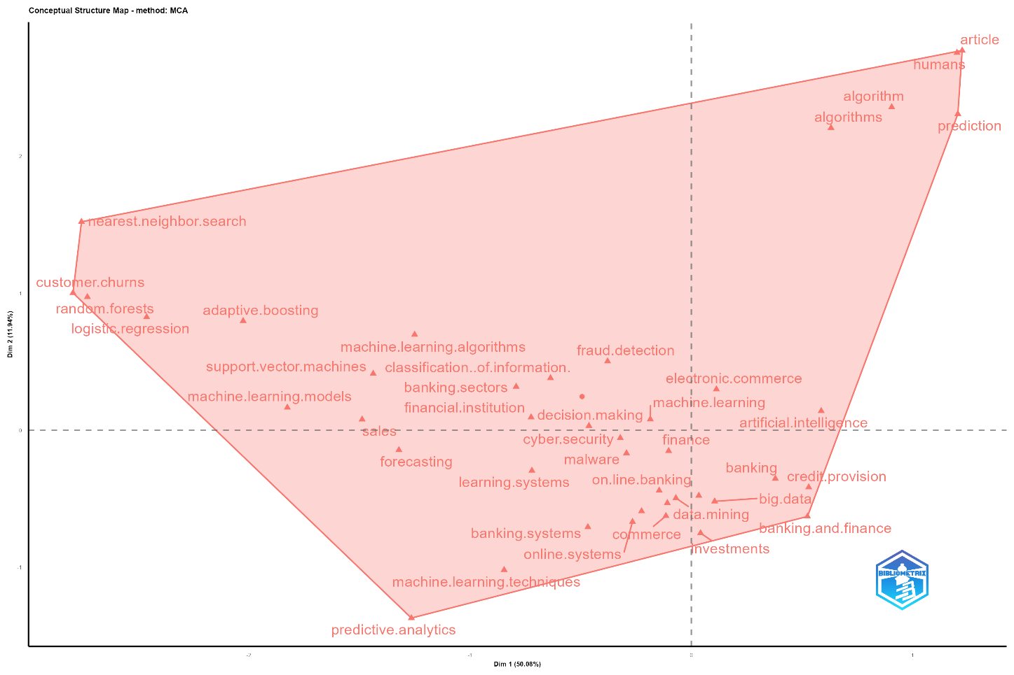
Conceptual Structure Map
Visualizes AI/ML themes in banking using Multiple Correspondence Analysis (MCA).
Clusters include predictive analytics, decision-making, and financial cybersecurity.
Identifies key research areas such as big data applications and online banking.
Dim 1 (Horizontal Axis): 50.08%
Dim 2 (Vertical Axis): 11.34%
These represent the percentage of variance explained by each dimension in the Multiple Correspondence Analysis (MCA).43707738

Slide 33
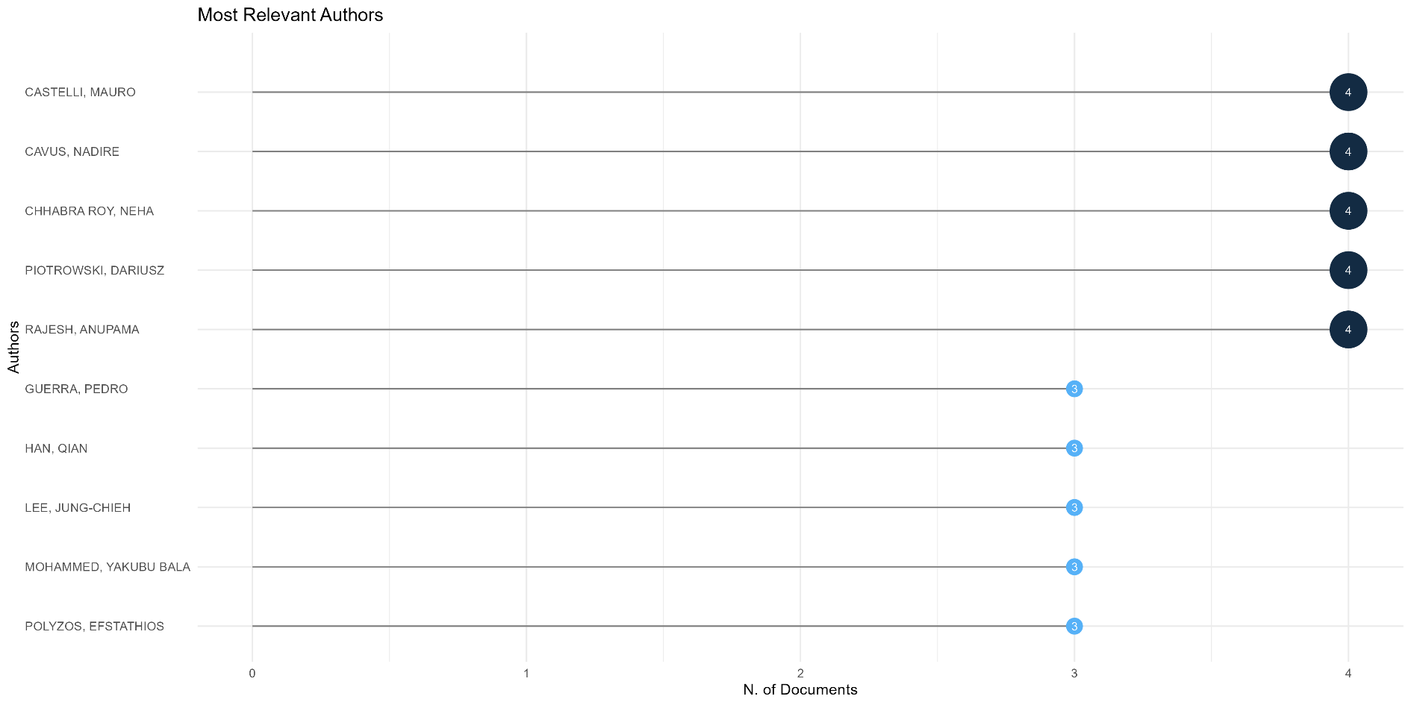
Most Relevant Authors
Leading contributors include Castelli Mauro, Cavus Nadire, and Rajesh Anupama.
Work spans fraud detection, risk management, and customer personalization.
Demonstrates strong interdisciplinary collaboration.

Slide 34
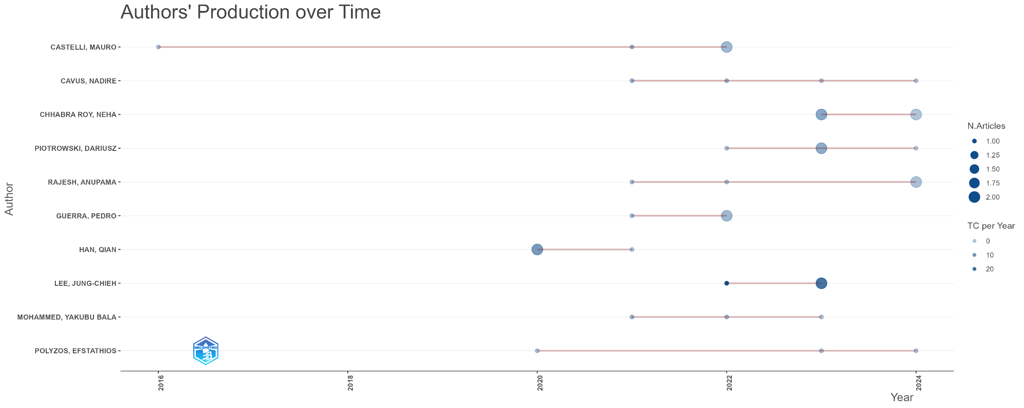
Authors’ Production Over Time
Identifies sustained contributions by key researchers over the years.
Increased author activity post-2017, aligning with technological advancements.
Highlights ongoing engagement in AI/ML-driven banking research.

